Slide 1
Introduction to Deep Learning
Eng Teong Cheah

Slide 2
Objective
Machine learning studies how computer systems can use data to improve performance. It combines ideas from statistics, data mining, artificial intelligence and optimization. Often it is used as a means of implementing artificially intelligent solutions.

Slide 3
Contents
1. Roots 2. The Road to Deep Learning 3. Success Stories

Slide 4

Deep Learning

Slide 5
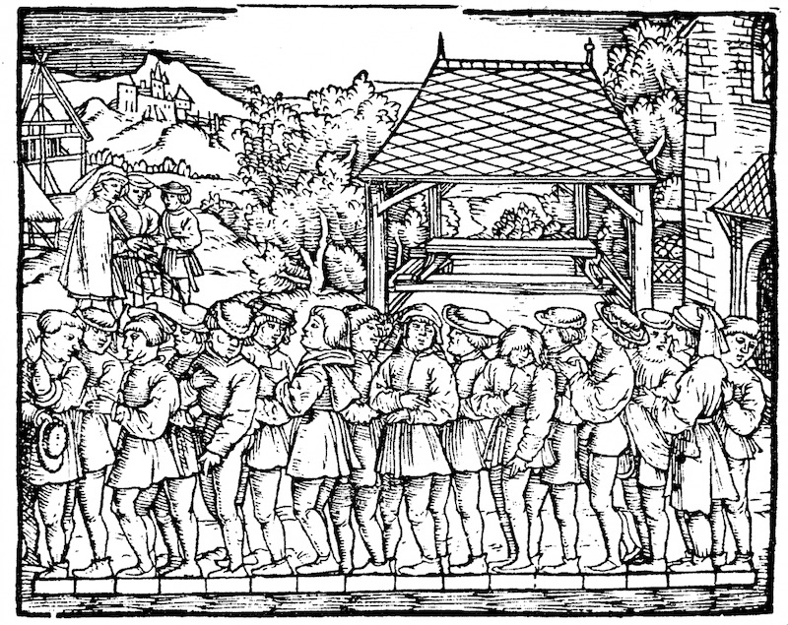
Figure 1 illustrate how this estimator works. 16 adult men were asked to line up in a row, when leaving church. Their aggregate length was then divided by 16 to obtain an estimate for what now amounts to 1 foot. This ‘algorithm’ was later improved to deal with misshapen feet – the 2 men with the shortest and longest feet respectively were sent away, averaging only over the remainder. This is one of the earliest examples of the trimmed mean estimate.
Figure 1 Estimating the length of a foot

Slide 6
The Road to Deep Learning

Slide 7
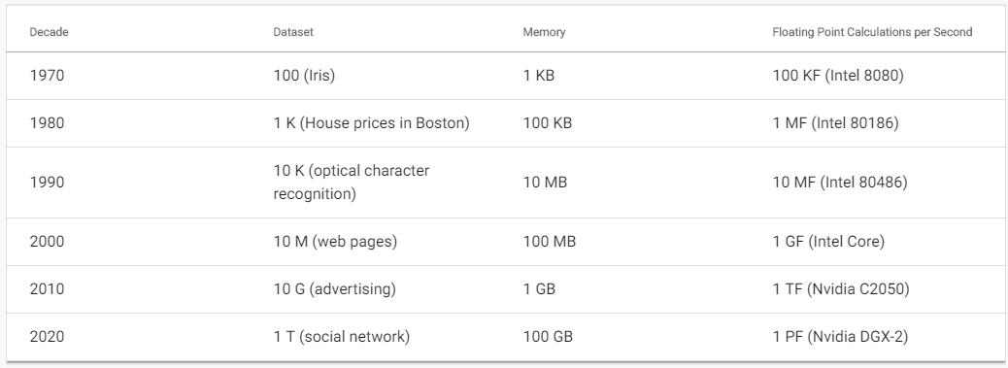
Dataset versus computer memory and computational power

Slide 8
Success Stories

Slide 9
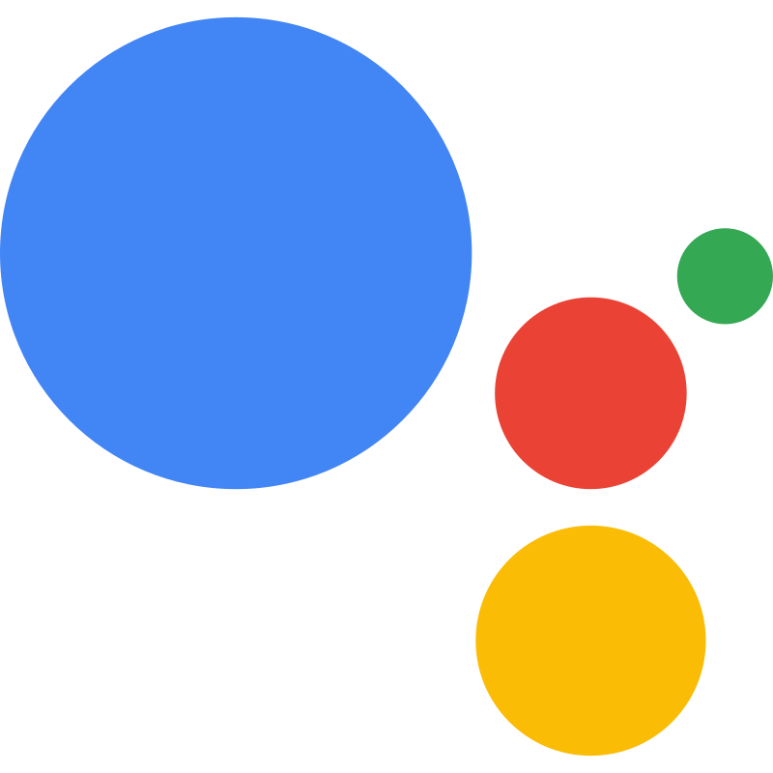



Slide 10
Thanks!
Does anyone have any questions?
Twitter: @walkercet
Blog: https://ceteongvanness.wordpress.com

Slide 11
Resources
Dive into Deep Learning

